Slide 1
Stage 8 Spinner Nightmare Course Designer: Stu Wilson
Spinner Nightmare is a 13 round unlimited course. There are 11 paper targets and 1 spinner. The best two hits per target will score and spinner must spin to score. The start signal is audible.
The Handgun start position is standing behind fault line. Handgun loaded and holstered. The PCC start position is standing behind fault line. PCC loaded, safety on, stock touching belt.
On the audible start signal, engage all targets from within the shooting area. The Spinner is worth 10 Alphas and is the first target in the tablet.

Slide 2
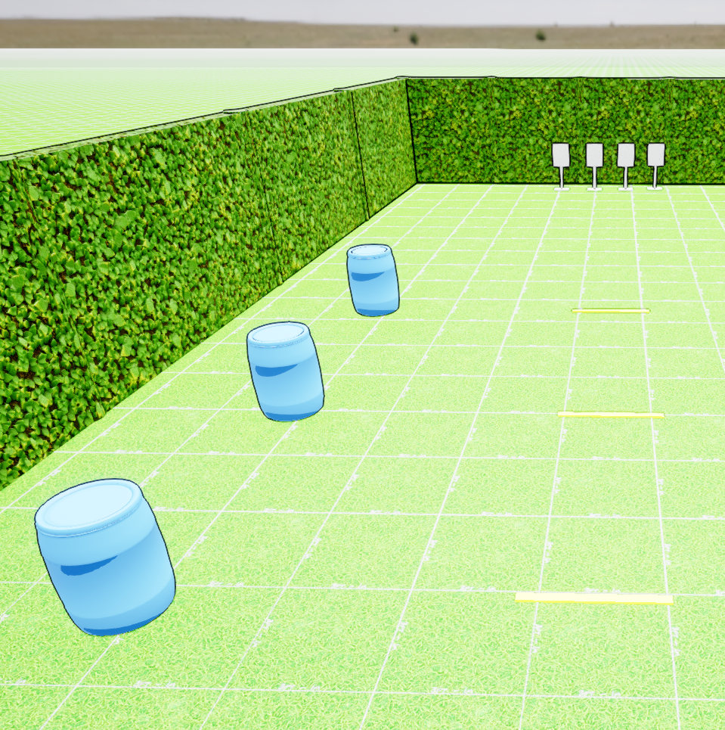
 | Stage 6, Bay 7 Stu’s Night-Mare Course Designer: Stu Wilson

